Slide 1

Executive Branch Ethics Code
A Quick Reference for the Public

Slide 2

The Executive Branch Ethics Commission
The Executive Branch Ethics Commission is an independent agency that administers and enforces the Executive Branch Code of Ethics codified in KRS Chapter 11A.
You must review all of the content othis slide before continuing.

Slide 3
All Public Servants are covered by the Ethics Code
Who is covered by the Ethics Code?
Every employee of an executive branch agency is a Public Servant covered by the Ethics Code. Public Servants are responsible for knowing and complying with these laws.
  Any person who is hired through a contract with a state agency to perform a function of a position that is full-time and non-seasonal is also considered to be a public servant.

Slide 4
Officers are Also Covered by the Ethics Code
Who Else is Covered by the Ethics Code- Officers
An officer is defined as the elected constitutional officers, such as the Governor, and major management personnel, including cabinet secretaries, commissioners, deputy secretaries and deputy commissioners, executive directors, general counsels, executive assistants, policy advisors, special assistants, administrative coordinators, executive advisors, staff assistants, and division directors. Any person who holds a personal services contract or other contract for employment to fulfill one of these positions on a full-time basis is also considered to be an officer. Also, members of certain boards are designated as officers. Officers can be merit or non-merit employees depending upon their duties. Officers must file Statements of Financial Disclosure with the Commission, which are public records, and must follow extra rules when they leave state government employment.
Close
Close
Close
Close

Slide 5
Who Else follows the Executive Branch Code of Ethics?
Lobbyists – Called EALs – Executive Agency Lobbyists
Their employers – the firm or company for which they work
Their clients – called Real Parties in Interest
Lobbyists, their employers, and their clients must register each year with the Ethics Commission and pay a $750 fee. Lobbyists must file an annual statement documenting their activities, compensation received for their lobbying activities, and any expenditures related to their activities in making contacts with Executive Branch officials.

Slide 6
When does a lobbyist have to register?
TO INFLUENCE AN EXECUTIVE AGENCY DECISION
An executive agency decision means a decision of an executive agency regarding the expenditure of state funds or funds of an executive agency with respect to the award of a contract, grant, lease, or other financial arrangement under which such funds are distributed or allocated. This shall also include decisions made concerning:
The parameters of requests for information and requests for proposal;
Drafting, adopting, or implementing a budget provision;
Administrative regulations or rules;
An executive order;
Legislation or amendments thereto; or
Other public policy decisions.
However, Executive Agency Decisions must result in the expenditure of state funds of $5000 or more or would financially impact the person’s client.

Slide 7
Prohibited conduct for public servants and officers
Using or attempting to use influence in any matter which involves a substantial conflict between their personal or private interest and their duties in the public interest;
Using or attempting to use any means to influence a public agency in derogation of the state at large;
Using official position or office to obtain financial gain for self or any members of family; or
Using or attempting to use official position to secure or create privileges, exemptions, advantages, or treatment for self or others in derogation of the public interest at large.

Slide 8
Examples
Quid Quo Pro: Seeking other employment or contracting services for self by making promises of action or inaction by the state.
Abusing state time, equipment, personnel, facilities or other state resources for
  private business purposes
  political campaign purposes
  sexual interests
Endorsing the products or services of a person or business who is regulated by or doing business with the state agency.
Engaging in decision making concerning a family member or close personal friend.

Slide 9
Confidential information
A Public Servant shall not knowingly disclose or use confidential information acquired in the course of their official duties, when such would further their own economic interests.

Slide 10
Stealing state funds
A Public Servant Shall not knowingly receive, directly or indirectly, any interest or profit arising from the use or loan of public funds in the public servant’s hands or to be raised through any state agency.

Slide 11
Prohibition against self dealing
A public servant shall not knowingly act as a representative for the Commonwealth or any agency in the transaction of any business or regulatory action with
  self, or
  any business in which the public servant or a member of their family has any interest greater than 5% of the total value thereof.
Notes:
Your spouse owns a business that is inspected and/or regulated by the division you work for. You must NOT inspect your spouse’s business nor any business in competition with your spouse. In addition, you should not work in the same division as persons inspecting your spouse’s business. Advisory opinions 93-26 and 94-15

Slide 12
Prohibition against self dealing
A public servant shall not knowingly hold, bid on, or negotiate any contract, lease, sale, or purchase made, entered into, awarded, or granted by the state agency for which they work.
This does not apply to
  Eminent domain – when the state seeks to purchase their property for the public good;
  Public funds disbursed through entitlement or agricultural programs;
  Spouse or child doing business with any state agency other than public servant’s agency;
  Purchases from a state agency available on the same terms to the general public or made at public auction; or
  Sale of craft items to a state park by an interim state employee designated as a craftsperson.
Notes:
NOTE: all contracts and agreements between you and a state agency must comply with the Model Procurement Code set forth in KRS Chapter 45A

Slide 13
Additional compensation
A public servant shall not knowingly accept compensation, other than that provided by law for public servants, for performance of official duties without the prior approval of the Commission.
Notes:
For activities not associated with your official duties – ie. Giving a speech about flowers at a garden club event – you may accept honoraria, being paid for jury duty, etc. This rule only applies to compensation provided for performing your official duties. (Advisory Opinions 93-31 and 94-14.)

Slide 14
Gifts
Public servants and their spouses and/or dependent child cannot accept any :
  gift, meal, gratuity, travel expense, alcoholic beverage, or honoraria
  totaling a value greater than $25 in a single calendar year
  from any person or business [does not include public agency] that
    does business with-
      Which means contracting, entering into an agreement, leasing, or otherwise exchanging services or goods with a state agency in return for payment by the state, including accepting a grant, but does not include accepting a state entitlement fund disbursement.
    Is regulated by-
    Seeks grants from-
    Is involved in litigation against-
    Is lobbying/attempting to influence the actions of-
    the agency in which the public servant is employed

Slide 15
Gifts
Gifts ARE:
  Payments
  Loans
  Subscriptions
  Advances
  Deposits of money
  Services
  Anything of value more than $25, unless consideration of equal or greater value is received
Gifts ARE NOT:
  Anything for which the public servant has paid market price or face value
  Gifts allowable to agencies pursuant to KRS 45A.097
  From family members in their capacity as family members
  From campaign contributors, so long as the donation complies with the Campaign Finance laws
  Door prizes available to the public
  A ticket to a sporting event if face value is paid for such ticket or admission
Notes:
Small green pamphlet in materials provided to you regarding gifts.

Slide 16
Outside employment
A public servant shall not accept outside employment from any person or business that
1. does business with or
2. is regulated by
their agency UNLESS the public servant has the approval of their appointing authority.

Slide 17
Before leaving state service
A public servant is prohibited from negotiating for future employment with a person or business that does business with or is regulated by their agency if the public servant is directly involved in any matters relating to the prospective employer . . .
UNLESS they first abstain in writing to their supervisor and recuse from being involved in any matters related to the prospective employer for the remainder of their employment.

Slide 18
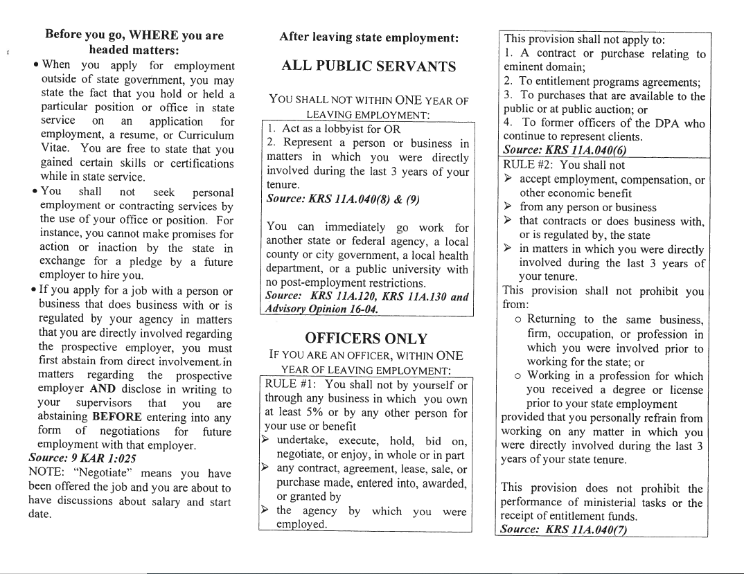

Slide 19
What if I’m not sure?
When in doubt, contact the agency’s ethics officer or
Executive Branch Ethics Commission
    Susan Stokley Clary, Executive Director
    Executive Branch Ethics Commission
    1025 Capital Center Drive, Suite 104
    Frankfort, KY 40601
    (502) 564-7954
            Susan.Clary@ky.gov
Notes:
19

